Slide 1
Reservoir Computing
Presentor: K Anurag

Slide 2
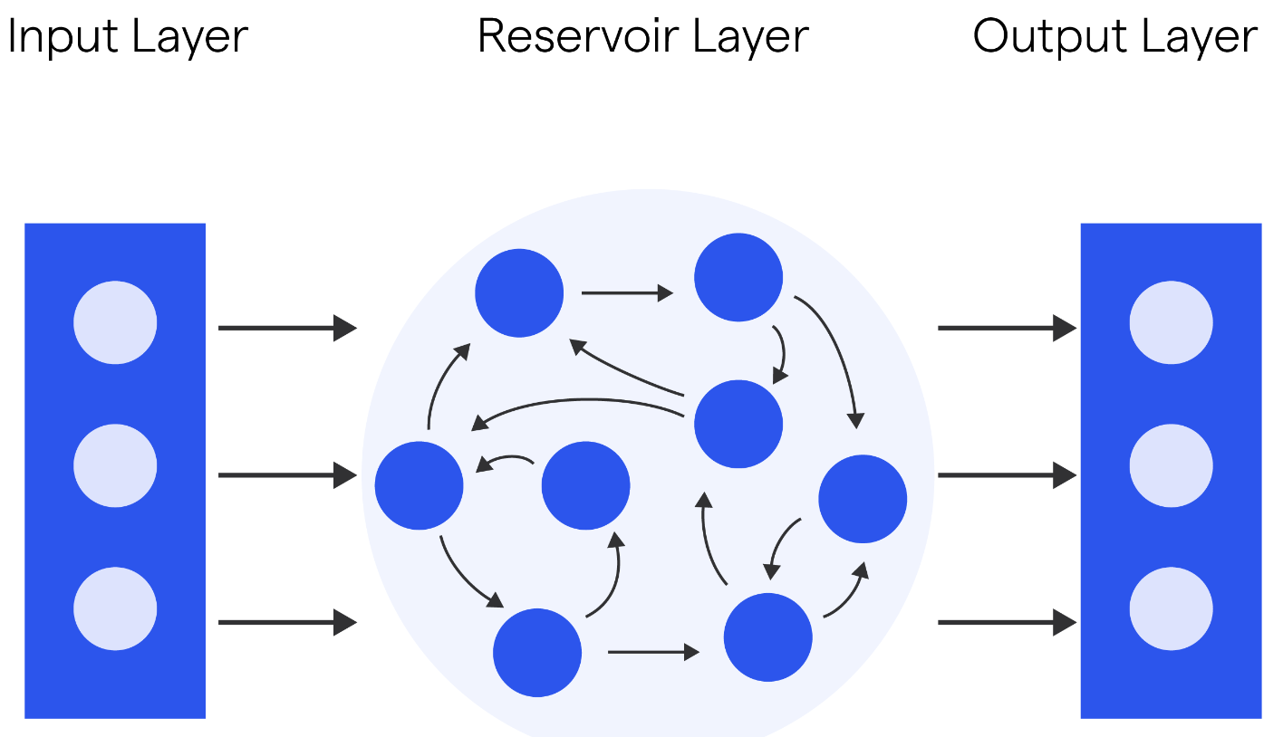
OVERVIEW OF RESERVOIR COMPUTING
PAPER-01
RC is a special type of neural network designed to handle complex, time-varying data. It uses a fixed, random network (reservoir) and focuses on training only the output layer.
Key-Point
Only the connections to the output layer need to be trained, which makes RC faster and easier to work with compared to other neural networks.
Applications:
Speech Recognition, Signal Processing, Robotics, etc.
takes the data
A large, fixed group of interconnected nodes that process the data. This part is unique because it doesn’t change during training.
Produces the final prediction after the data has passed through the reservoir.
1/5

Slide 3
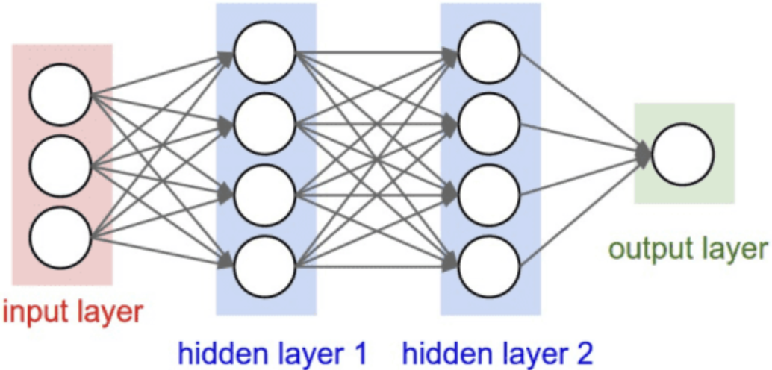
How RC is better than traditional Feedforward NN?
PAPER-01
Architecture: RC: Includes a dynamic reservoir that captures time-dependent patterns. Feedforward NN: Processes data in a linear, step-by-step manner without feedback or memory.
Training-Efficiency: RC: Only the output layer needs to be trained, which is faster and requires less computational power. Feedforward NN: Requires training of all layers, which can be time-consuming and resource-intensive.
Memory-Processing: RC: Can handle sequences and time-based data naturally, thanks to its reservoir's memory capabilities. Feedforward NN: Lacks inherent memory, making it less effective for tasks requiring context or temporal dependencies.
Flexibility: RC: Can be easily adapted to different types of data and tasks with minimal changes. Feedforward NN: Often requires significant reconfiguration or retraining for different tasks.
2/5

Slide 4
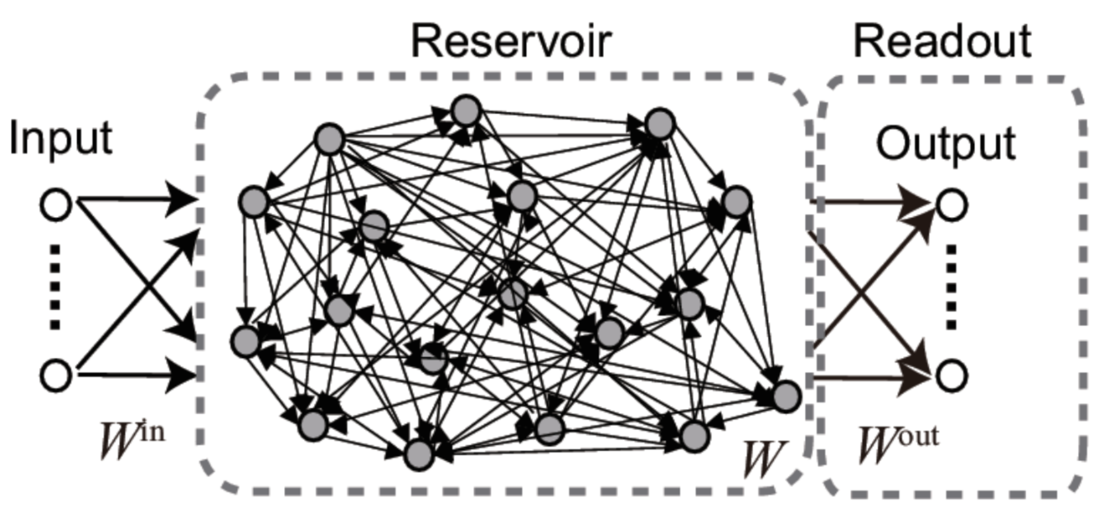
Understanding Reservoir Computing: Equations
and Concepts
PAPER-02
State Equation Update:
x(t+1) = f(Wx(t) + Bu(t))
where,
x(t): reservoir state vector
f: activation function (e.g., tanh)
W: reservoir weight matrix
B: input weight matrix
u(t): input signal
Output Equation:
y(t) = Cx(t)
where,
y(t): output signal
C: output weight matrix
3/5

Slide 5
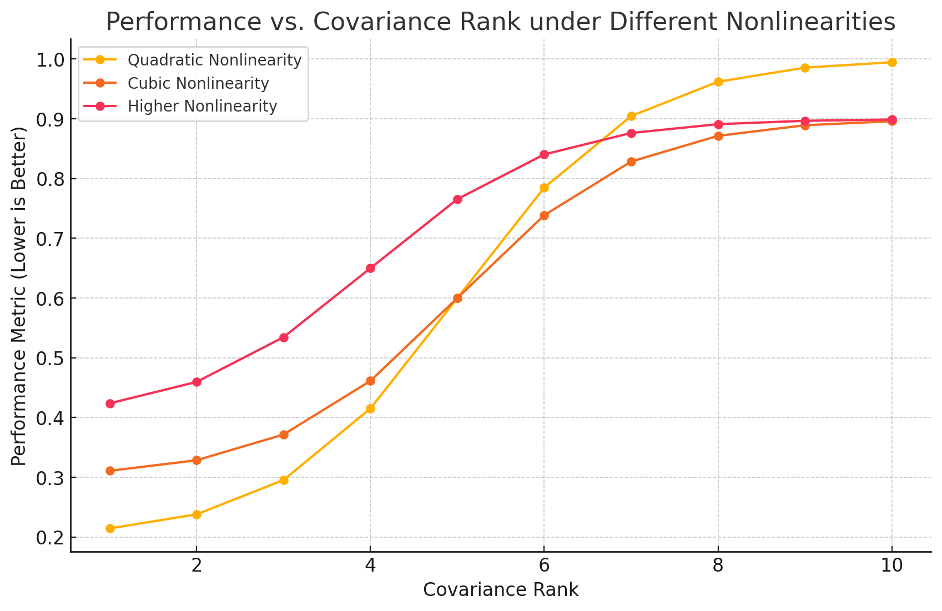
Interaction of Rank and Nonlinearity in a
Three Node Reservoir Computer
PAPER-03
Covariance Rank: (1): Reflects the number of linearly independent signals produced by the nodes. (2): Higher rank generally indicates better learning potential but depends on the node’s nonlinearity.
Nonlinearity: (1): Nodes apply nonlinear transformations (e.g., squaring, cubing) that modify input signals. (2): The nature of these nonlinearities directly impacts how the reservoir combines and processes information.
Graph Analysis: As the covariance rank increases, performance generally improves, indicating better learning capacity. This suggests that finding the right balance between rank and nonlinearity is key to getting the best performance.
4/5

Slide 6

Implementation in Python
Link
5/5

Slide 7
Thank you!

